Slide 1
Lecture 8: Modeling Humans: Incentive Design
Instructor: Chien-Ju (CJ) Ho

Slide 2
Logistics: Project Proposal
Due this Friday
Topics: Focus on “humans” in computation
I might suggest/require changes after the proposal
You may check the list of example/past projects
Logistics
Include all teammates using Gradescope interface
See the link on the website for the requirements
http://chienjuho.com/courses/cse518a/project-proposal.pdf

Slide 3
Logistics: Assignment 3
Assignment 3 has been posted on the website
3 long-ish math questions that extend the lecture today
Due: Oct 12 (Wed)
A bit less than 2 weeks after the Assignment 2 deadline
To avoid clashing with the deadline of project milestone 1 (Oct 14)

Slide 4
Logistics: Presentation
For presenters:
Give a 55~60 min presentation based on the required reading and at least two optional reading (3 optional readings for 3-person groups) of a lecture
The papers are the “backbone” of the presentation
Prepare 2 reading questions for the required reading
Prepare at least 2 discussion sessions
Lead the discussion for the discussion sessions
Template format (if you are not sure what to do):
Explain the required reading (5~10 min)
Discussion session (5~10 min)
Discussion on the optional readings (15~20 min)
Another discussion session (5~10 min)
Discussion on the optional readings (15~20 min)
A short summary (3~5 min)
Feel free to be creative and include materials outside of the papers

Slide 5
Logistics: Presentation
For presenters:
Talk to me one week before your presentation.
Default time: talk to me after class
You need to be ready for the following before meeting with me
Finish reading the papers
A structure of your presentation
Two reading questions for the required reading
Topics for one or two discussion sessions
Send me the slides before the noon of the presentation day

Slide 6
Today’s Lecture: Modeling Incentives

Slide 7
Warm-Up Discussion
What are the incentives that motivate you/people to do things?
Can you try to model the incentives? For example, how do you mathematically specify the relationships of the “strength” of the incentives and how that impacts your actions?
Mechanism design: Given your model of how humans respond to incentives, how can you design mechanisms (set of rules) that encourage people to do what you want them to do? (You can try to think about these in some specific applications).

Slide 8
Today’s Lecture: Modeling Incentives
Game theory basics
Utility, games, equilibrium
Example usage in crowdsourcing
Contract design (Principal agent model)
Proper scoring rules (eliciting truthful probability estimates)
Example usage in crowdsourcing
Prediction markets
Peer prediction
Example usage in crowdsourcing
Peer grading in MOOCs

Slide 9
Game Theory
Mathematical study of interactions between rational and self-interested agents.
Agents are often assumed to be rational and choose actions to maximize their expected utility.
Notes:
A natural technique to consider in the model and analysis of crowdsourcing

Slide 10
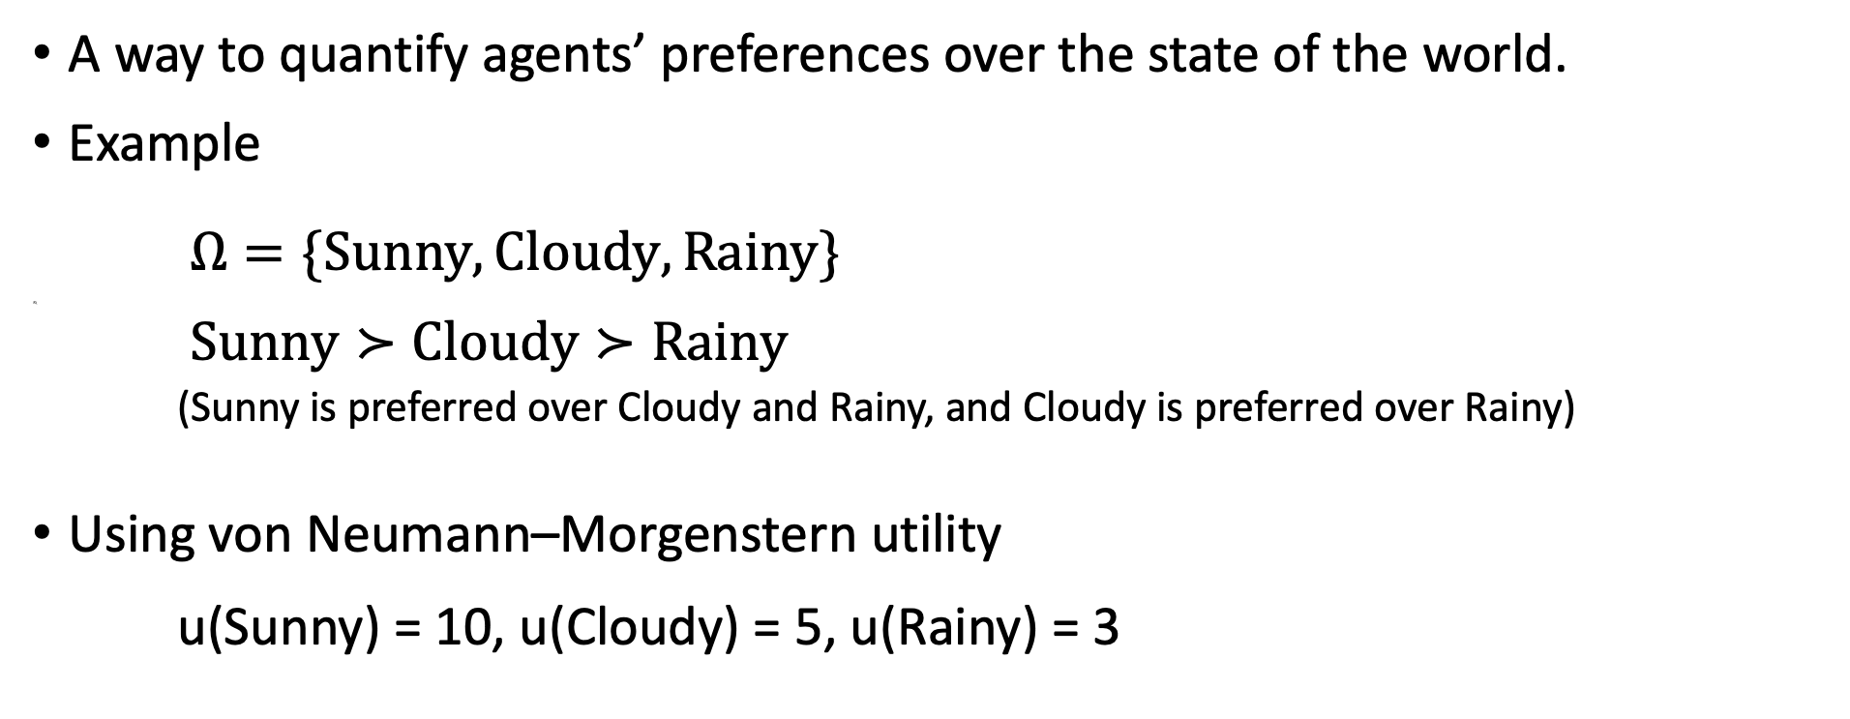
Utility
A way to quantify agents’ preferences over the state of the world.
Example
$Ω=\{\text{Sunny},\text{Cloudy}, \text{Rainy}\}$
R\
$Sunny≻Cloudy≻Rainy$
(Sunny is preferred over Cloudy and Rainy, and Cloudy is preferred over Rainy)
Using von Neumann–Morgenstern utility
u(Sunny) = 10, u(Cloudy) = 5, u(Rainy) = 3
A natural way to use numerical value to represent preference. It also satisfies nice properties:
Completeness
Transitivity
Continuity
Independence

Slide 11
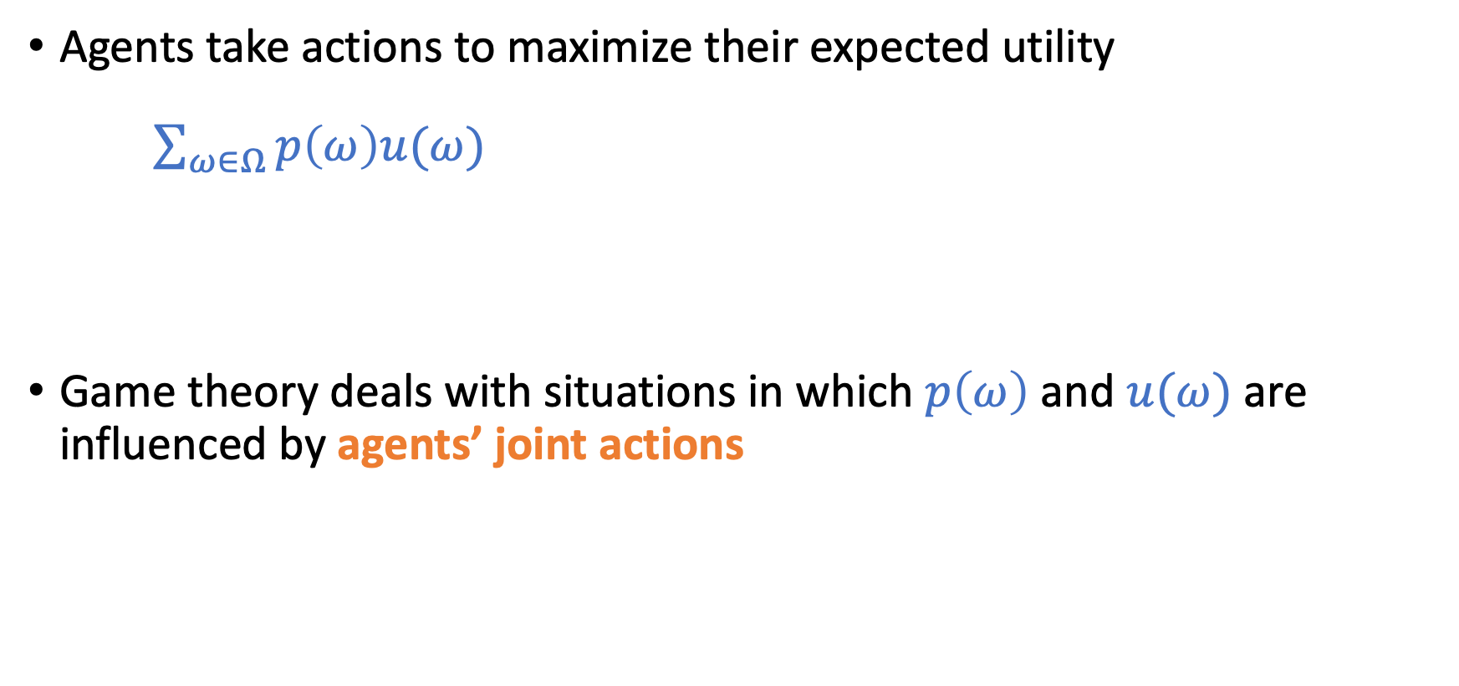
Expected Utility Theory
Agents take actions to maximize their expected utility
$\sum_{ω∈Ω}{p\left(ω\right)u(ω)}$
There have been discussions/extensions on risk attitudes, irrational behavior, etc.
Game theory deals with situations in which $p\left(ω\right)$ and $u(ω)$ are influenced by agents’ joint actions

Slide 12
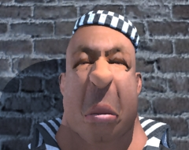
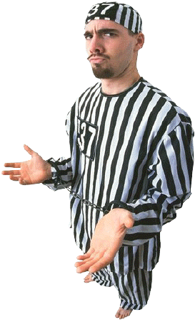
Example 1: Prisoner’s Dilemma
B
Normal-form game
 | Stay Silent | Confess
Stay Silent | A: 6 months B: 6 months | A: 10 years B: free
Confess | A: free B: 10 years | A: 5 years B: 5 years
A
Solution Concept
What should the prisoners do?
“Confess” is a dominant strategy – it maximizes the prisoner’s utility no matter what action the other player chooses.

Slide 13
Normal-Form Game
Players take actions simultaneously
The elements of a normal-form game
Players: (prisoner A, prisoner B)
Strategies: (stay silent, confess)
Payoffs: (sentences for all strategy combinations)
 | B Stay Silent | B Confess
A Stay Silent | A: 6 months B: 6 months | A: 10 years B: free
A Confess | A: free B: 10 years | A: 5 years B: 5 years

Slide 14
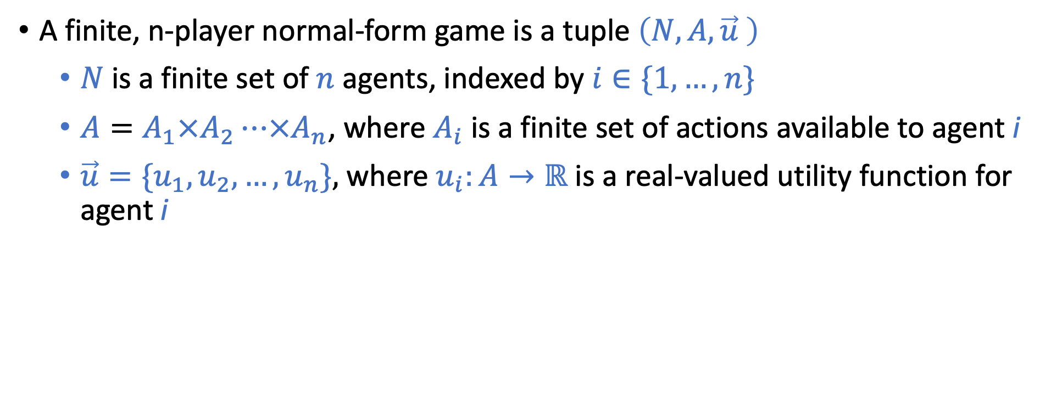
Normal-Form Game (More formally)
A finite, n-player normal-form game is a tuple $\left(N,A, \vec{u} \right)$
$N$is a finite set of $n$ agents, indexed by $i∈\{1,…,n\}$
$A=A_{1}×A_{2}⋯×A_{n}$, where $A_{i}$ is a finite set of actions available to agent i
$\vec{u}=\{u_{1},u_{2},…,u_{n}\},$ where $u_{i}:A→ℝ$ is a real-valued utility function for agent i

Slide 15
Example 2: Coordination Game
Two friends A and B are deciding what to do on Friday night
A prefers to go to the movie
B prefers to go to the bar
Both prefer to do something together than doing something separately
B
 | Movie | Bar
Movie | (2, 1) | (0, 0)
Bar | (0, 0) | (1, 2)
“Nash equilibrium” of this game
A
What is the “solution” of the game: what should A and B do?
(Movie, Movie) and (Bar, Bar) seem to be two stable outcomes

Slide 16
Example 3: Rock, Paper, Scissors
A zero-sum game
 | Rock | Paper | Scissors
Rock | (0, 0) | (-1, 1) | (1, -1)
Paper | (1, -1) | (0, 0) | (-1, 1)
Scissors | (-1, 1) | (1, -1) | (0, 0)
Is there a dominant strategy?
Are there stable pairs of actions?
Need a more general solution concept.

Slide 17
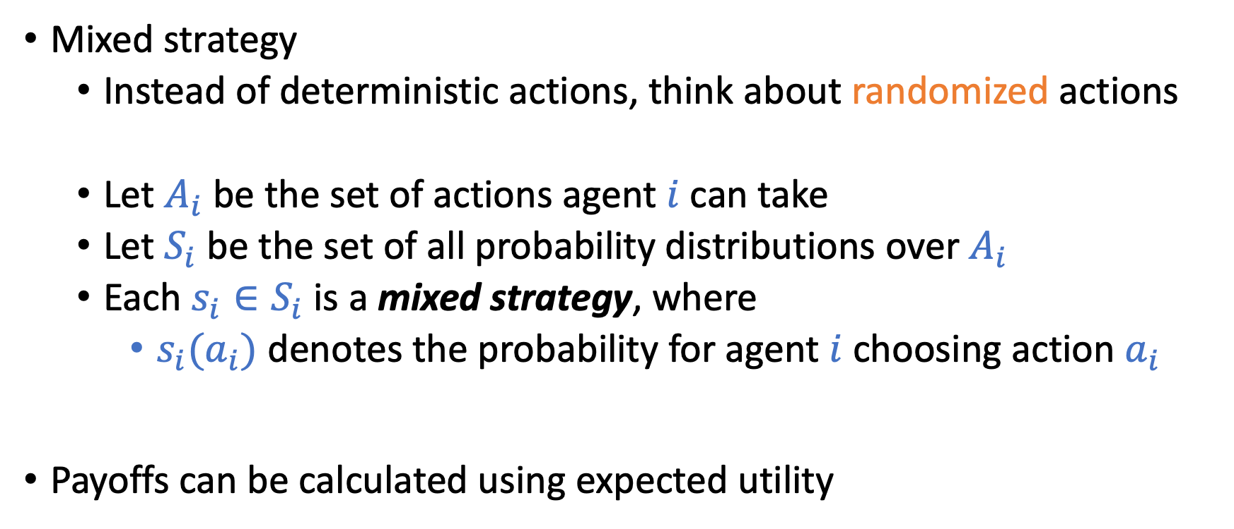
Definitions
Mixed strategy
Instead of deterministic actions, think about randomized actions
Let $A_{i}$ be the set of actions agent $i$ can take
Let $S_{i}$ be the set of all probability distributions over $A_{i}$
Each $s_{i}∈S_{i}$ is a mixed strategy, where
$s_{i}(a_{i})$ denotes the probability for agent $i$ choosing action $a_{i}$
Payoffs can be calculated using expected utility

Slide 18
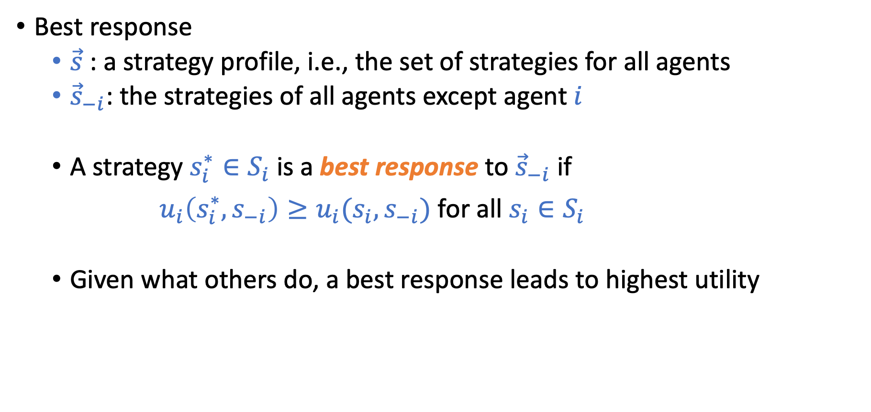
Definitions
Best response
$\vec{s}$ : a strategy profile, i.e., the set of strategies for all agents
${\vec{s}}_{−i}$: the strategies of all agents except agent $i$
A strategy $s_{i}^{∗}∈S_{i}$ is a best response to ${\vec{s}}_{−i}$ if
$u_{i}\left(s_{i}^{∗},s_{−i}\right)≥u_{i}(s_{i},s_{−i})$ for all $s_{i}∈S_{i}$
Given what others do, a best response leads to highest utility
There could be multiple best responses.
If a best response put positive probability on 2 or more actions, the agent must be indifferent between these actions. (Think about why)

Slide 19
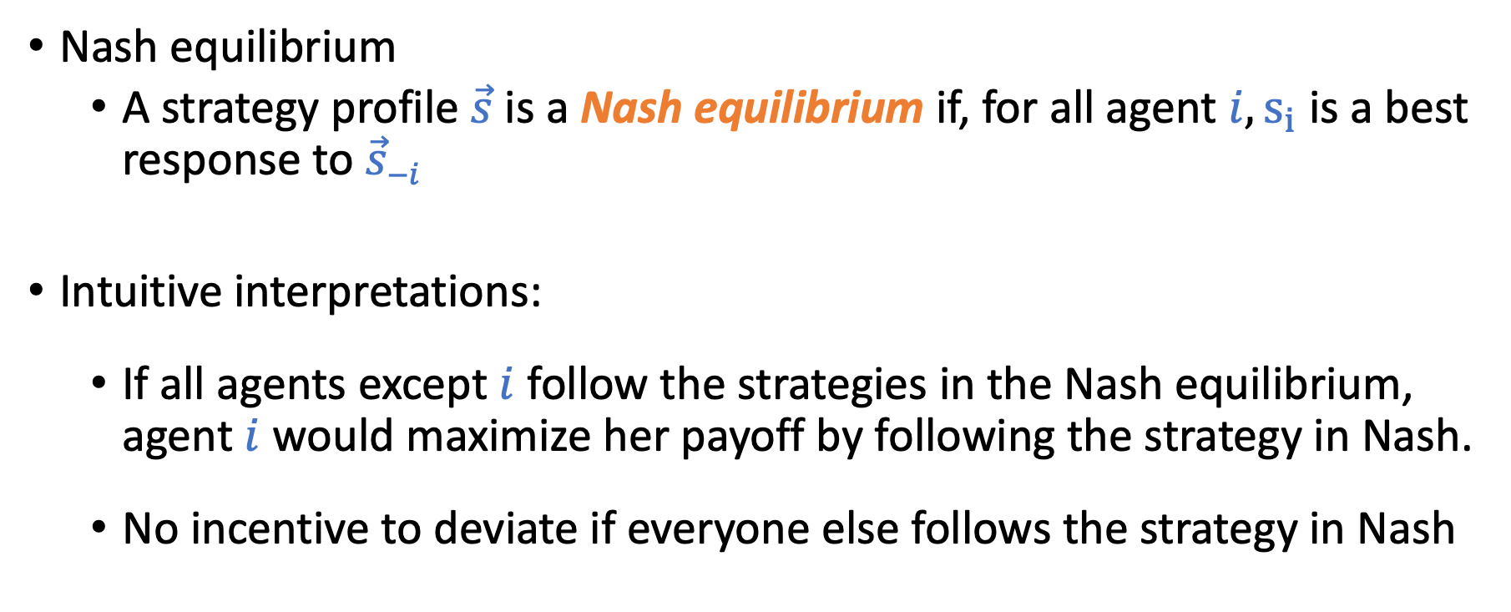
Definitions
Nash equilibrium
A strategy profile $\vec{s}$ is a Nash equilibrium if, for all agent $i, s_{i}$ is a best response to ${\vec{s}}_{−i}$
Intuitive interpretations:
If all agents except $i$ follow the strategies in the Nash equilibrium, agent $i$ would maximize her payoff by following the strategy in Nash.
No incentive to deviate if everyone else follows the strategy in Nash

Slide 20
Let’s look at the examples again
 | B Stay Silent | B Confess
A Stay Silent | A: 6 months B: 6 months | A: 10 years B: free
A Confess | A: free B: 10 years | A: 5 years B: 5 years
(Confess, Confess) is the dominant strategy equilibrium
Strongest solution concept

Slide 21
Let’s look at the examples again
 | Movie | Bar
Movie | (2, 1) | (0, 0)
Bar | (0, 0) | (1, 2)
(Movie, Movie) and (Bar, Bar) are pure strategy Nash equilibria
Are there other equilibria?
Using the indifference property to derive a mixed-strategy equilibria

Slide 22
Let’s look at the examples again
 | Rock | Paper | Scissors
Rock | (0, 0) | (-1, 1) | (1, -1)
Paper | (1, -1) | (0, 0) | (-1, 1)
Scissors | (-1, 1) | (1, -1) | (0, 0)
Both players play each action with 1/3 probability is the mixed strategy Nash equilibrium
It is the unique equilibrium

Slide 23
Theorem (Nash, 51):
Every game with a finite number of players and actions has at least one equilibrium.
Notes:
This is the “existence” proof. Computing the equilibrium could be hard (computationally expensive).
If it’s hard to calculate the equilibrium, can we really expect humans to follow the equilibrium?
There have been recent studies developing new solution concepts which assume humans are “learning” to adapt to the game.

Slide 24


Extensive-Form Game
Agents take decisions in a sequential manner
Players
Strategies
 | Surrender | Fight
In | (2, 1) | (0, 0)
Out | (1, 2) | (1, 2)
in
out
Apple: $ 1b
Google: $ 2b
surrender
fight
Payoff
Apple: $ 2 b
Google: $ 1b
Apple: $ 0
Google: $ 0

Slide 25
Solution Concepts in Extensive Games
There are some weird cases by directly extending Nash equilibrium.
Teacher
Nash equilibrium:
Teacher chooses “Don’t give a test”
Student chooses (Relax, Cheat)
Don’t give a test
Give a test
Student
Student
Study
Relax
Prepare
Cheat
Is it stable?
(3,1)
(1,3)
(2,1)
(0,0)
Why is this the weird case?
Student gives a “non-credible threat”
“I’ll choose to cheat if you give a test”

Slide 26
Solution Concepts in Extensive Games
Subgame Perfect Equilibrium (SPE)
Play in each subgame is a Nash equilibrium.
Rule out the “non-credible threat”
Teacher
SPE
Teacher chooses “Give a test”
Student chooses (Relax, Prepare)
Don’t give a test
Give a test
Student
Student
Study
Relax
Prepare
Cheat
Can usually be calculated using backward induction.
(3,1)
(1,3)
(2,1)
(0,0)

Slide 27
Applying Game Theory in this Course
Formulate users’ incentives
Describe the game structure
Sometime there are no interactions between workers. It becomes a simpler optimization problem.
Analyze the equilibrium as the prediction of the outcome
Mechanism design
Specify the desired outcome
Design incentive and game structures such that the outcome is the equilibrium

Slide 28


Practice Example – Contract Design
Requester Utility = [expected task value – expected payment]
Bad Outcome worth $1 | Good Outcome worth $5
$1 | $3
Bad Outcome worth $1 | Good Outcome worth $5
$1 | $1
worker
Utility = [expected payment – cost ]
worker
High effort
Low effort
High effort
Low effort
 | Bad Outcome | Good Outcome
High effort | Prob: 0.1 | Prob: 0.9
Low effort | Prob: 0.8 | Prob: 0.2
Cost: $1
Cost: $0
Which contract should the requester choose?
Can be generalized to any real-valued contracts (Principal Agent problem)

Slide 29
Discussion
The main assumption we usually make in incentive design is that users are rational. While it approximates human behavior fine in some cases, this assumption has often been criticized.
Questions
What are the examples of the “non-rational” human behavior you can think of?
Can you still try to model the non-rational behavior?

Slide 30
Example of Human Bias
Present bias:
Humans value immediate payoffs heavier than future payoffs.
What will happen if we don’t require project milestone reports?
Herding bias:
Humans tend to follow what others do/say.
Will you eat at a restaurant with a lot of people lining up or another with no one inside.
Prospect theory:
Nobel-winning theory in explaining biases in decision-making with uncertainty events.
And more…
A growing research direction to account for human biased behavior in computational systems.
First workshop on Behavioral EC

Slide 31
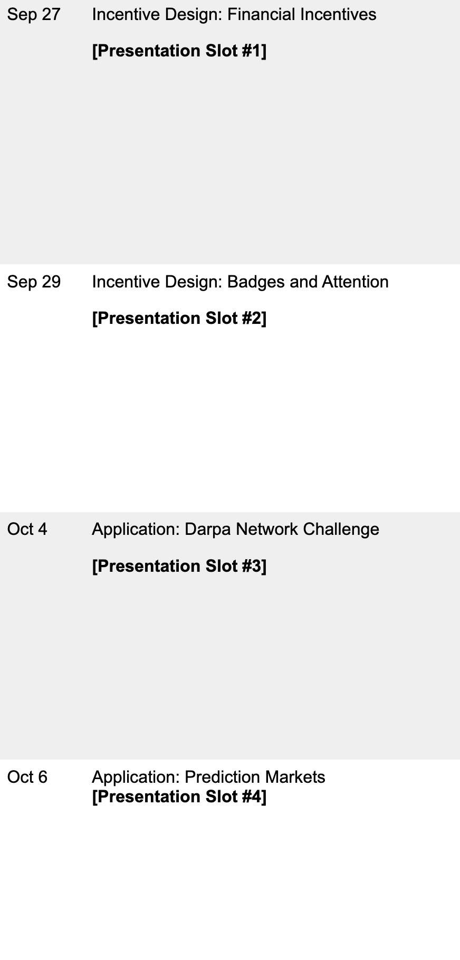
Are workers really rational in financial incentives?
Can we formulate non-financial incentives?
Incentivizing users through social networks
Using market mechanisms for eliciting users’ beliefs

Slide 32
Proper Scoring Rules

Slide 33
Incentivizing Truthful Reports About Probabilities
Example scenarios:
Ask a weather forecaster: will it rain tomorrow?
Ask a political researcher: will Trump win 2020 election?
Ask a Microsoft employer: will the new version of Office be shipped on time?
Want to obtain forecasts about future events
How do we make sure we obtain truthful reports?

Slide 34
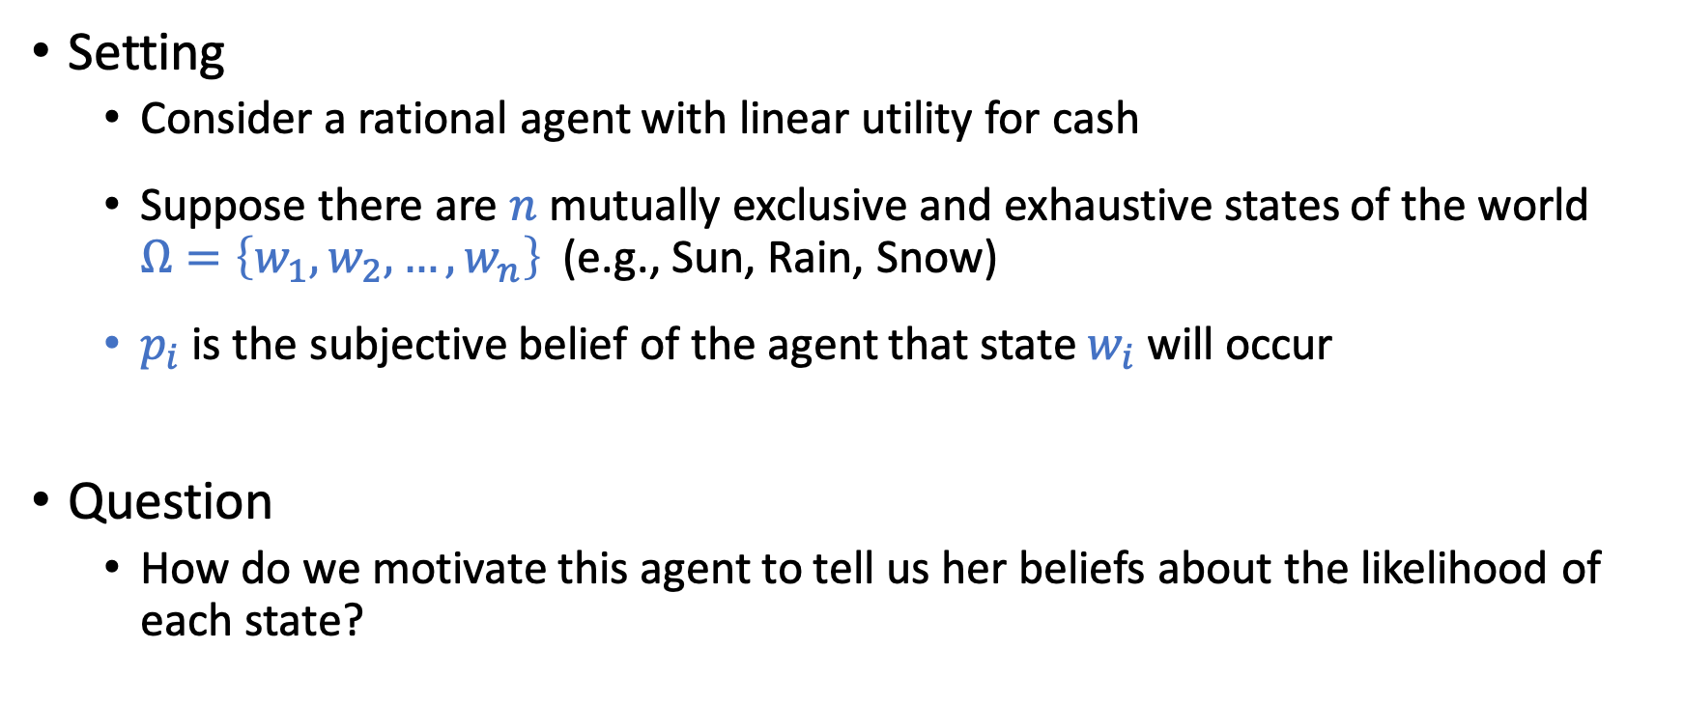
Incentivizing Truthful Reports
Setting
Consider a rational agent with linear utility for cash
Suppose there are $n$ mutually exclusive and exhaustive states of the world $Ω=\left\{w_{1},w_{2},…,w_{n}\right\}$ (e.g., Sun, Rain, Snow)
$p_{i}$ is the subjective belief of the agent that state $w_{i}$ will occur
Question
How do we motivate this agent to tell us her beliefs about the likelihood of each state?

Slide 35
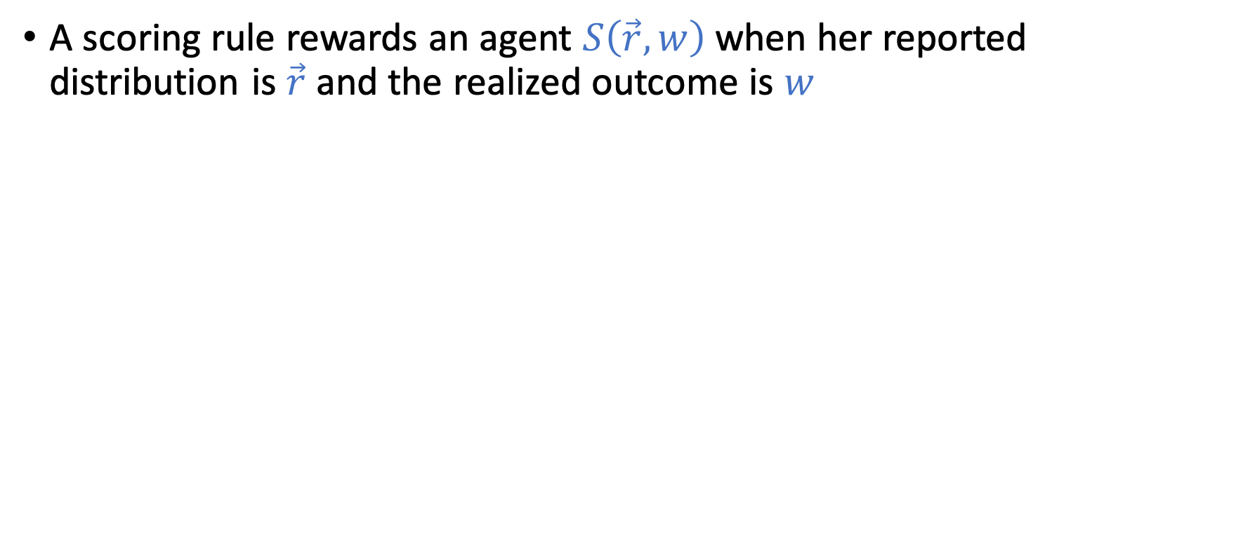
Scoring Rules
A scoring rule rewards an agent $S\left(\vec{r},w\right)$ when her reported distribution is$\vec{r}$ and the realized outcome is $w$

Slide 36
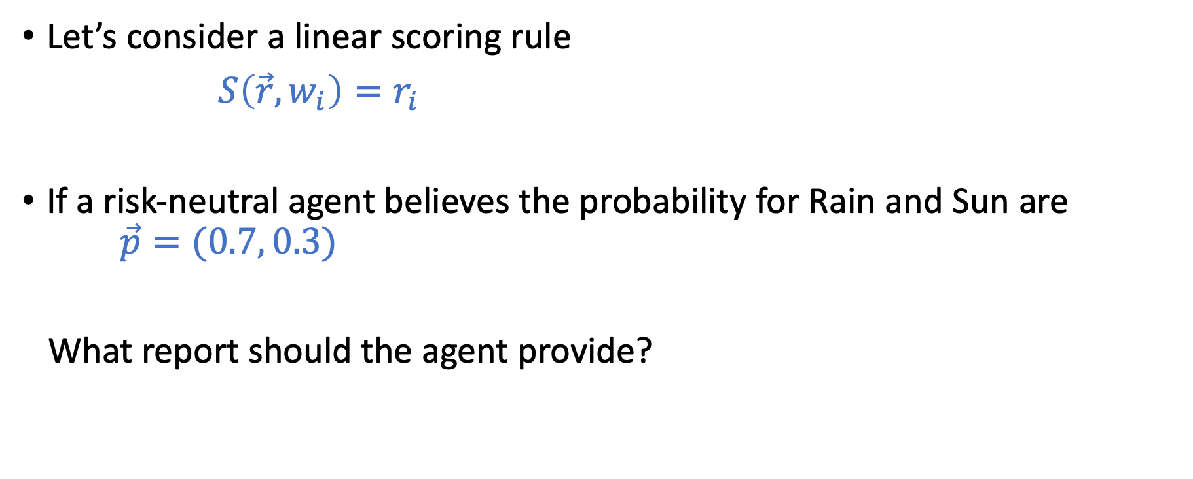
Scoring Rules
Let’s consider a linear scoring rule
$S\left(\vec{r},w_{i}\right)=r_{i}$
If a risk-neutral agent believes the probability for Rain and Sun are $\vec{p}=(0.7, 0.3)$
What report should the agent provide?

Slide 37
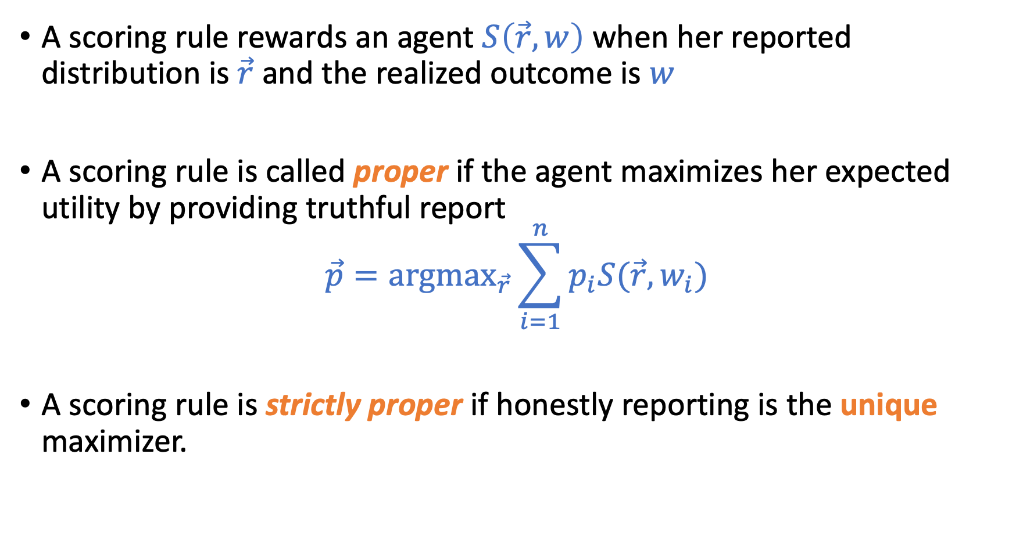
Scoring Rules
A scoring rule rewards an agent $S\left(\vec{r},w\right)$ when her reported distribution is$\vec{r}$ and the realized outcome is $w$
A scoring rule is called proper if the agent maximizes her expected utility by providing truthful report
$$\vec{p}=\text{argma}{\text{x}}_{\vec{r}}\sum_{i=1}^{n}{p_{i}S(\vec{r},w_{i})}$$
A scoring rule is strictly proper if honestly reporting is the unique maximizer.

Slide 38
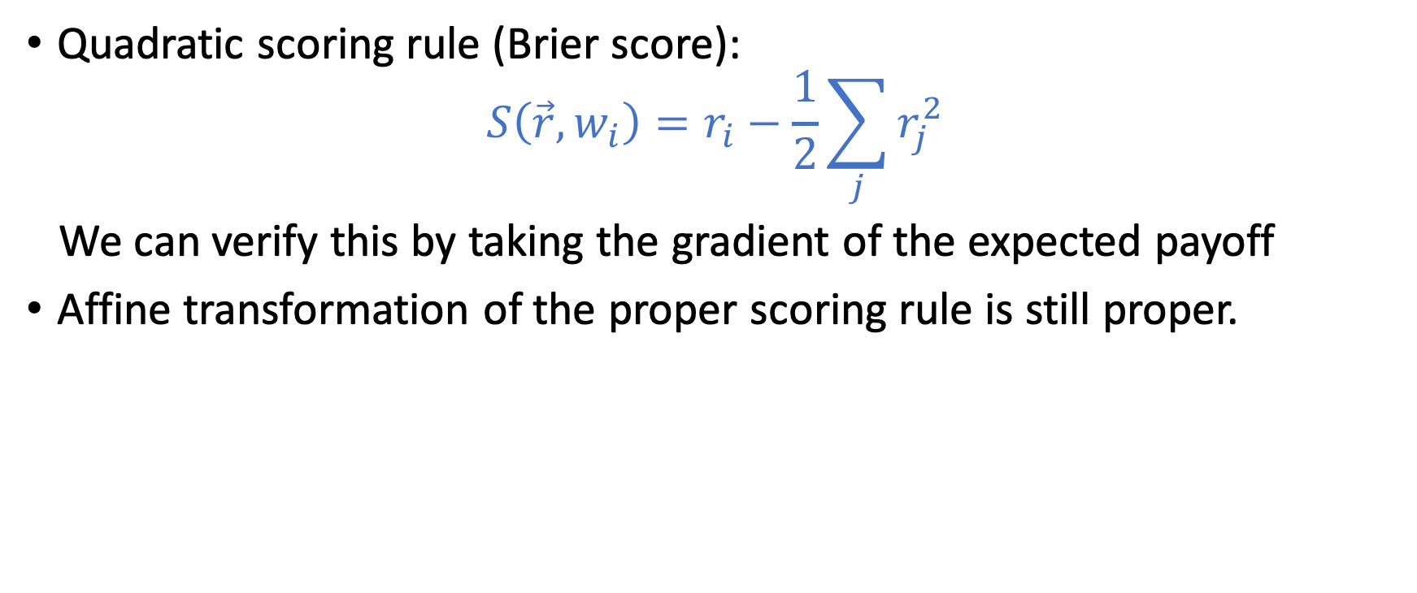
Examples of Strictly Proper Scoring Rules
Quadratic scoring rule (Brier score):
$$S\left(\vec{r},w_{i}\right)=r_{i}−\frac{1}{2}\sum_{j}{r_{j}^{2}}$$
We can verify this by taking the gradient of the expected payoff
Affine transformation of the proper scoring rule is still proper.

Slide 39
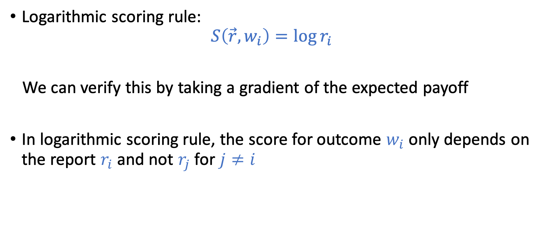
Examples of Strictly Proper Scoring Rules
Logarithmic scoring rule:
$$S\left(\vec{r},w_{i}\right)=\log{r_{i}}$$
We can verify this by taking a gradient of the expected payoff
In logarithmic scoring rule, the score for outcome $w_{i}$ only depends on the report $r_{i}$ and not $r_{j}$ for $j≠i$

Slide 40
More examples?
How do we construct a strictly proper scoring rule?
How many strictly proper scoring rules are there?

Slide 41
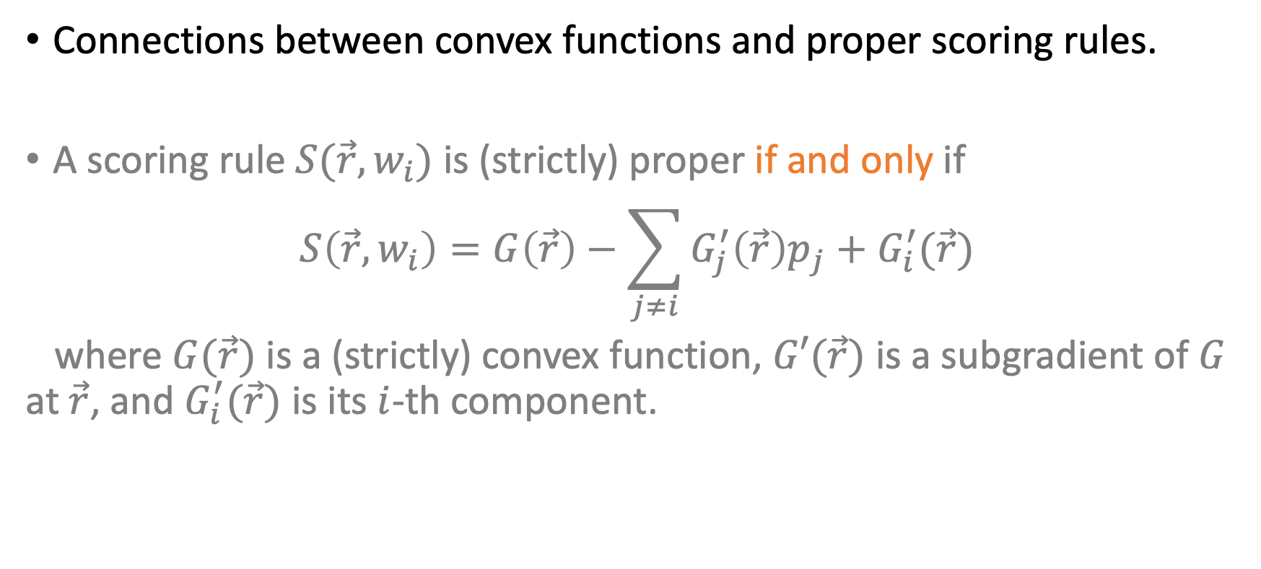
Characterization of Proper Scoring Rules
Connections between convex functions and proper scoring rules.
A scoring rule $S(\vec{r},w_{i})$ is (strictly) proper if and only if
$$S\left(\vec{r},w_{i}\right)=G\left(\vec{r}\right)−\sum_{j≠i}{G_{j}^{′}\left(\vec{r}\right)p_{j}+G_{i}^{′}(\vec{r})}$$
where $G(\vec{r})$ is a (strictly) convex function, $G′(\vec{r})$ is a subgradient of $G$ at $\vec{r}$, and $G_{i}^{′}(\vec{r})$ is its $i$-th component.
Section 3.1 of Strictly Proper Scoring Rules, Prediction, and Estimation by Gneiting and Raftery.

Slide 42
Connection to Prediction Market

Slide 43
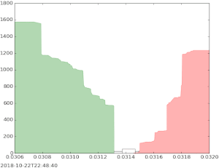
Designing Automatic Market Makers
Traditional market mechanisms might not work when the market is thin

Slide 44
Designing Automatic Market Makers
Goal of the market maker
Incentivize multiple agents to share their beliefs, and find a way to aggregate these beliefs into a unified prediction
1. Could use one scoring rule per agent, but not clear how to aggregate
2. Market itself is an aggregation mechanism (use final price as the prediction). However, standard stock-market-style trading might encounter issues for less popular predictions (market is too thin).

Slide 45
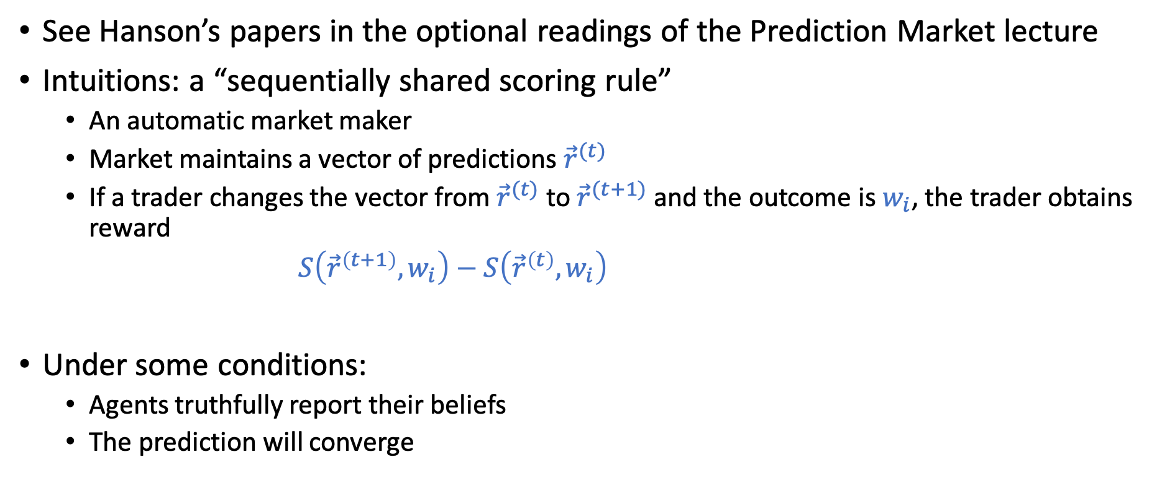
Market Scoring Rules
See Hanson’s papers in the optional readings of the Prediction Market lecture
Intuitions: a “sequentially shared scoring rule”
An automatic market maker
Market maintains a vector of predictions ${\vec{r}}^{(t)}$
If a trader changes the vector from ${\vec{r}}^{(t)}$ to ${\vec{r}}^{(t+1)}$ and the outcome is $w_{i}$, the trader obtains reward
$S\left({\vec{r}}^{\left(t+1\right)},w_{i}\right)−S\left({\vec{r}}^{\left(t\right)},w_{i}\right)$
Under some conditions:
Agents truthfully report their beliefs
The prediction will converge

Slide 46
Market Scoring Rules
The connection to convex optimization opens up an interesting line of research in the design of efficient market maker…

Slide 47
We won’t cover too much on prediction markets. In case you are interested, below are a few more papers to follow up:
A New Understanding of Prediction Markets Via No-Regret Learning. Chen and Vaughan. EC 2010.
An Optimization-Based Framework for Automated Market-Making. Abernethy, Chen, and Vaughan. EC 2011.
and more (the papers by these authors)

Slide 48
Very Brief Intro of Peer Prediction
See more discussion in Assignment 3

Slide 49
Eliciting Truthful Reports
Scoring rule relies on the “truth” to be revealed in the future
What if there is no ground truth (or the ground truth is hard to obtain)
Do you like this movie?
Peer grading in MOOCs
Output agreement:
Randomly pick two persons
If their reports match, reward them 1, otherwise reward 0
Truthful reporting is not an equilibrium (you are encouraged to report the majority’s opinion)

Slide 50
Peer Prediction
How to fix the issue?
Assume knowledge about the report distribution, re-weighting the rewards to make sure truthful reporting is a equilibrium
Drawbacks:
Require knowledge of the prior
There are usually multiple equilibrium (including naïve bad ones…)
Still an ongoing research area
Some nice theoretical results, however there is little practical success so far
Eliciting Informative Feedback: The Peer-Prediction Method. Miller et al. 2004

Slide 51
Related Course
The course on peer grading at Northwestern by Jason Hartine.
https://sites.northwestern.edu/hartline/eecs-497-peer-grading/

Slide 52
Assignment 3

Slide 53
Cooperation and Repeated Prisoner’s Dilemma
Prisoner’s dilemma predicts that people are not going to cooperate in the game setup, but in practice, people sometimes do.
Will look at this using repeated versions of prisoner’s dilemma

Slide 54
Peer Grading and Peer Prediction
Can we design ”incentives” for peer grading?
Ground truth (goodness of assignment) is hard to obtain
Randomly pick two students to grade the same assignment
Rewarding “the same score” is probably not a good idea
Every grader can just give high score for every assignment
How should we do it?

Slide 55
Information Design with Bayesian Persuasion
A company wants to hire interns from our class and asks me for recommendation letters
Assumption
30% of students are “good” -> meet their requirement
They don’t know who are good but I know
How do I write letters to maximize the number of students getting hired?

